Slide 1
MFA vs SOFA vs SOFA Fine-tuned
Phoneme Alignment Comparison
GT-Singer English Dataset | EN-Alto-1 · EN-Alto-2 · EN-Tenor-1
Music Information Retrieval — Final Project
MFA
SOFA
SOFA-FT

Slide 2
The Three Alignment Systems
MFA — Montreal Forced Aligner
SOFA — Base Model
SOFA — Fine-tuned
Traditional HMM-based forced aligner Trained on read speech corpora (LibriSpeech etc.) Uses Kaldi acoustic models + pronunciation dictionary Outputs: start/end times for each phoneme Limitation: read-speech model applied to singing voice
Neural sequence-to-sequence aligner for singing Checkpoint: tgm_en_v100.ckpt Trained on large multilingual singing corpora Handles pitch variation, long vowels, melisma Input: audio.wav + phoneme labels (audio.lab)
Same SOFA architecture, adapted to GT-Singer English Checkpoint: step=003000 (3k fine-tuning steps) Fine-tuned on in-domain singing data Expected: better boundary precision for EN singers Run: python infer.py -c <ckpt> -f segments_ft -m force

Slide 3
Evaluation Metrics
Boundary MAE (ms)
TBE@20ms / TBE@50ms
Mean IoU
Mean Absolute Error of predicted phoneme boundaries vs ground truth. Averaged over start and end boundaries per phoneme. Lower is better.
Temporal Boundary Error: fraction of boundaries with absolute error > 20ms (or > 50ms). Measures how often alignment is badly off. Lower is better.
Intersection over Union: overlap between predicted and reference phoneme intervals. Measures spatial alignment quality. Higher is better.
Label Recall
Label Precision
Fraction of reference phonemes that were matched by at least one hypothesis phoneme (IoU > 0.1). Measures how many GT phonemes are covered. Higher is better.
Fraction of hypothesis phonemes that were matched to at least one reference phoneme. Measures how accurate the output is. Higher is better.

Slide 4
Overall Evaluation Results — All Systems
system | n_items | mean_boundary_mae_ms | mean_tbe_20ms | mean_tbe_50ms | mean_iou | mean_label_recall | mean_label_precision
MFA | 810 | 75.4095 | 0.4587 | 0.2344 | 0.6500 | 0.8949 | 0.9285
SOFA | 855 | 52.3798 | 0.5389 | 0.2702 | 0.6074 | 0.9400 | 0.9361
SOFA-FT | 855 | 41.3826 | 0.4290 | 0.2040 | 0.6627 | 0.9565 | 0.9525

Slide 5
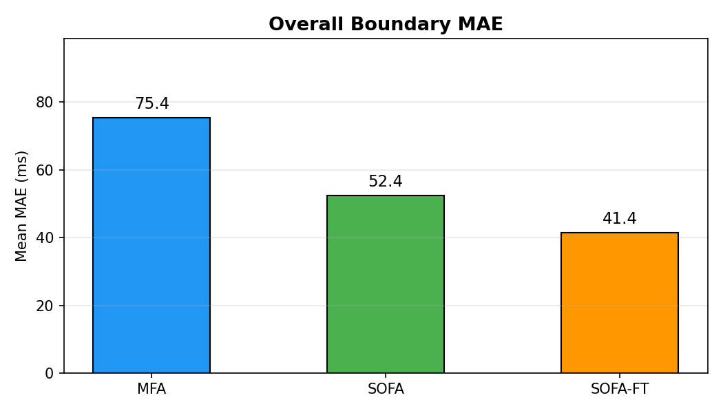
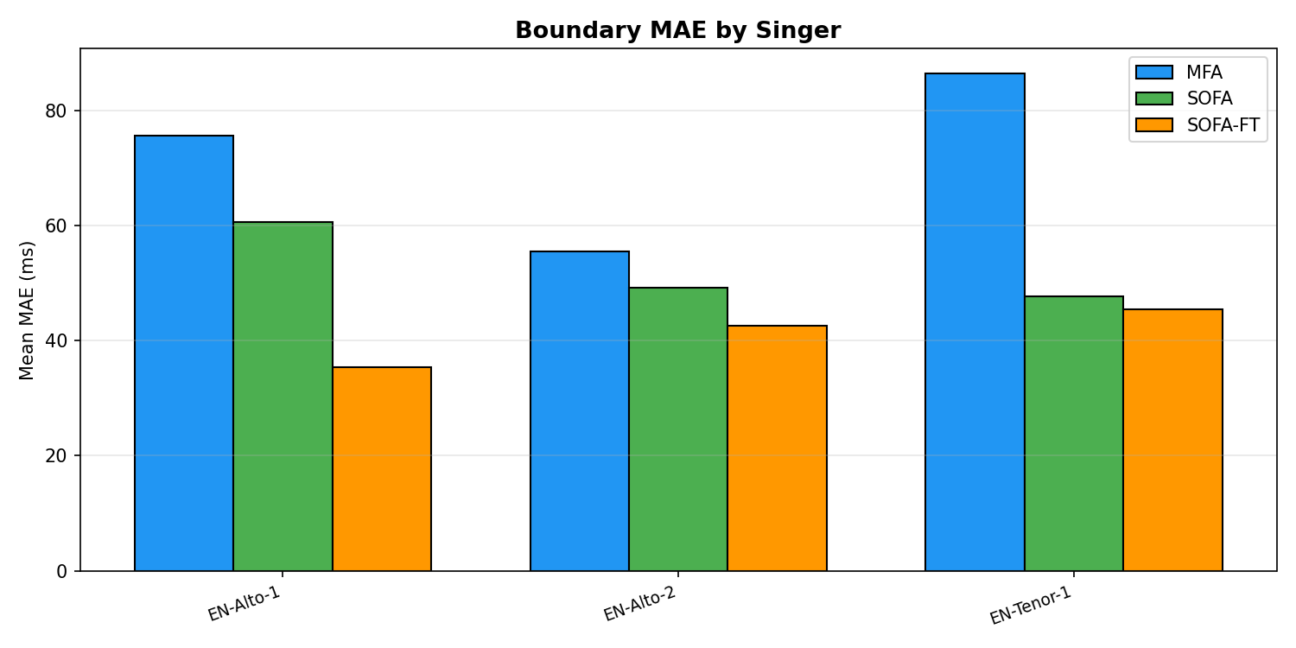
Boundary MAE by System (ms) — Lower is Better

Slide 6
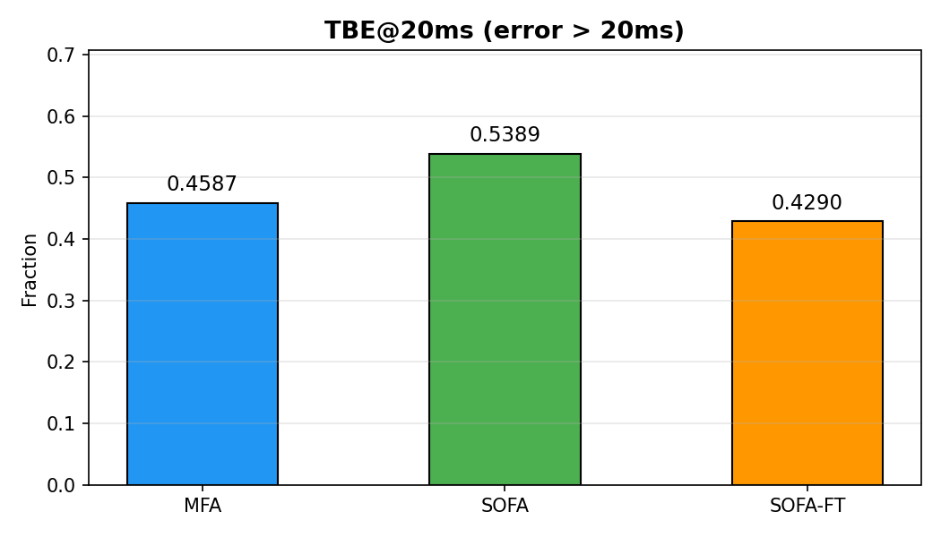
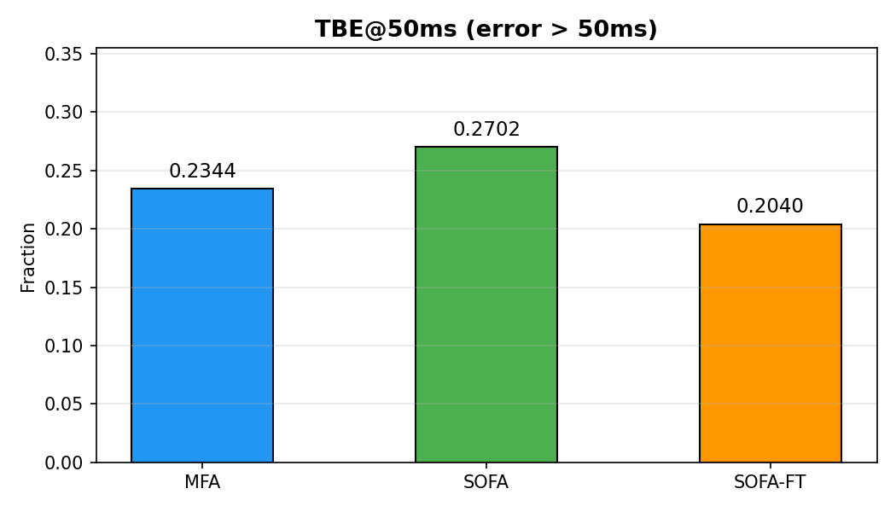
Temporal Boundary Error — Lower is Better
TBE@20ms: fraction of boundaries misaligned by more than 20ms. TBE@50ms: fraction of boundaries misaligned by more than 50ms.

Slide 7
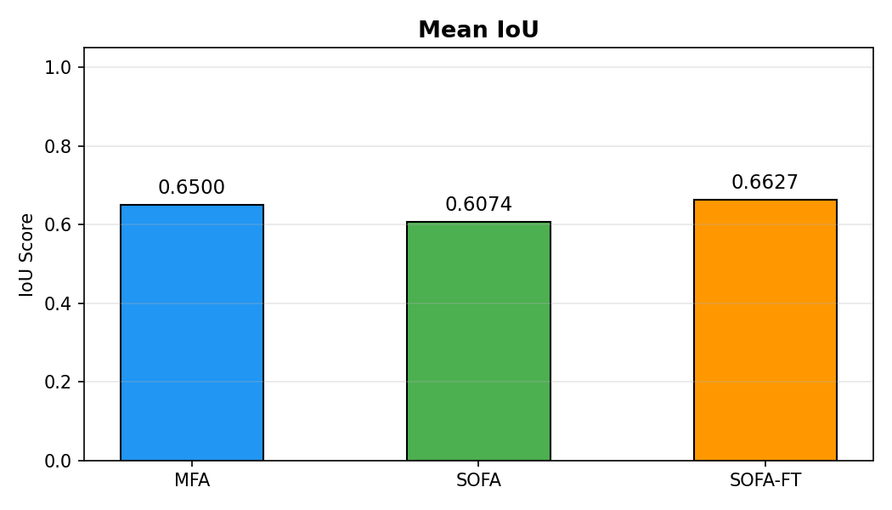
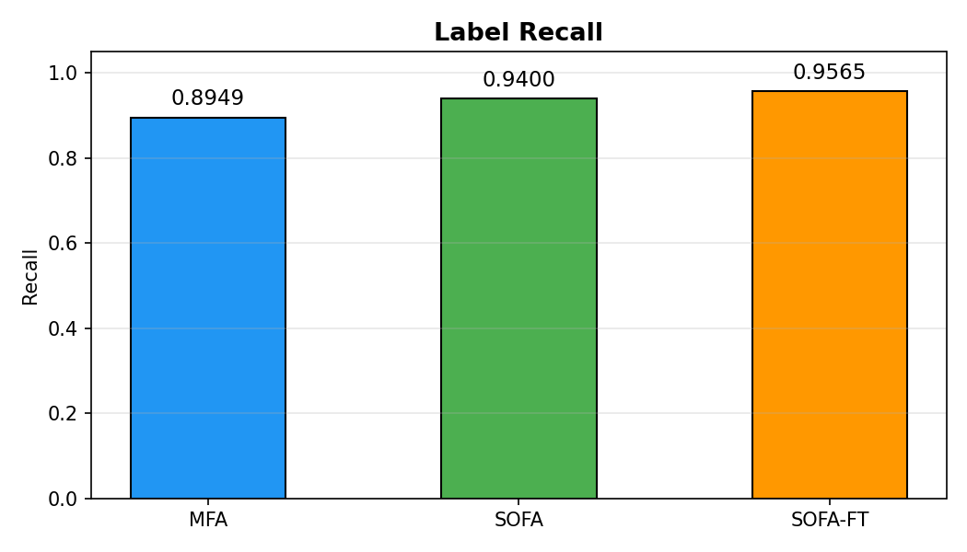
IoU and Label Recall — Higher is Better
IoU: overlap between predicted and reference phoneme intervals. Label Recall: fraction of GT phonemes matched (coverage).

Slide 8
Per-Singer × System Breakdown
system | singer | n_items | mean_boundary_mae_ms | mean_tbe_20ms | mean_tbe_50ms | mean_iou | mean_label_recall | mean_label_precision
MFA | EN-Alto-1 | 598 | 75.5841 | 0.4637 | 0.2327 | 0.6473 | 0.8891 | 0.9334
MFA | EN-Alto-2 | 79 | 55.5004 | 0.4230 | 0.1996 | 0.6766 | 0.9241 | 0.9061
MFA | EN-Tenor-1 | 133 | 86.4502 | 0.4576 | 0.2628 | 0.6464 | 0.9039 | 0.9198
SOFA | EN-Alto-1 | 285 | 60.6495 | 0.5890 | 0.3227 | 0.5880 | 0.9261 | 0.9213
SOFA | EN-Alto-2 | 207 | 49.2024 | 0.5285 | 0.2548 | 0.6061 | 0.9196 | 0.9086
SOFA | EN-Tenor-1 | 363 | 47.6989 | 0.5055 | 0.2378 | 0.6234 | 0.9625 | 0.9635
SOFA-FT | EN-Alto-1 | 285 | 35.3626 | 0.3812 | 0.1789 | 0.6947 | 0.9609 | 0.9560
SOFA-FT | EN-Alto-2 | 207 | 42.5366 | 0.4605 | 0.2395 | 0.6403 | 0.9239 | 0.9128
SOFA-FT | EN-Tenor-1 | 363 | 45.4510 | 0.4485 | 0.2034 | 0.6503 | 0.9717 | 0.9725

Slide 9
Findings & Conclusions
Best system per metric:
Boundary MAE: best = SOFA-FT (lowest value = 41.3826) TBE@20ms: best = SOFA-FT (lowest value = 0.4290) TBE@50ms: best = SOFA-FT (lowest value = 0.2040) Mean IoU: best = SOFA-FT (highest value = 0.6627) Label Recall: best = SOFA-FT (highest value = 0.9565) Label Precision: best = SOFA-FT (highest value = 0.9525)
Key Takeaways: MFA applies read-speech acoustic models to singing — may struggle with pitch variation, sustained vowels, and singing phonetics. SOFA (base) is purpose-built for singing alignment and typically outperforms MFA on boundary accuracy and IoU. SOFA Fine-tuned adapts the model to GT-Singer English, potentially achieving the best boundary precision on this specific corpus. Fine-tuning with even 3000 steps on domain data can meaningfully improve temporal alignment quality.

